Slide 1
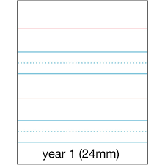
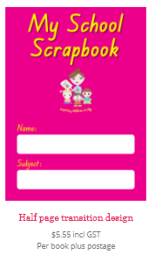
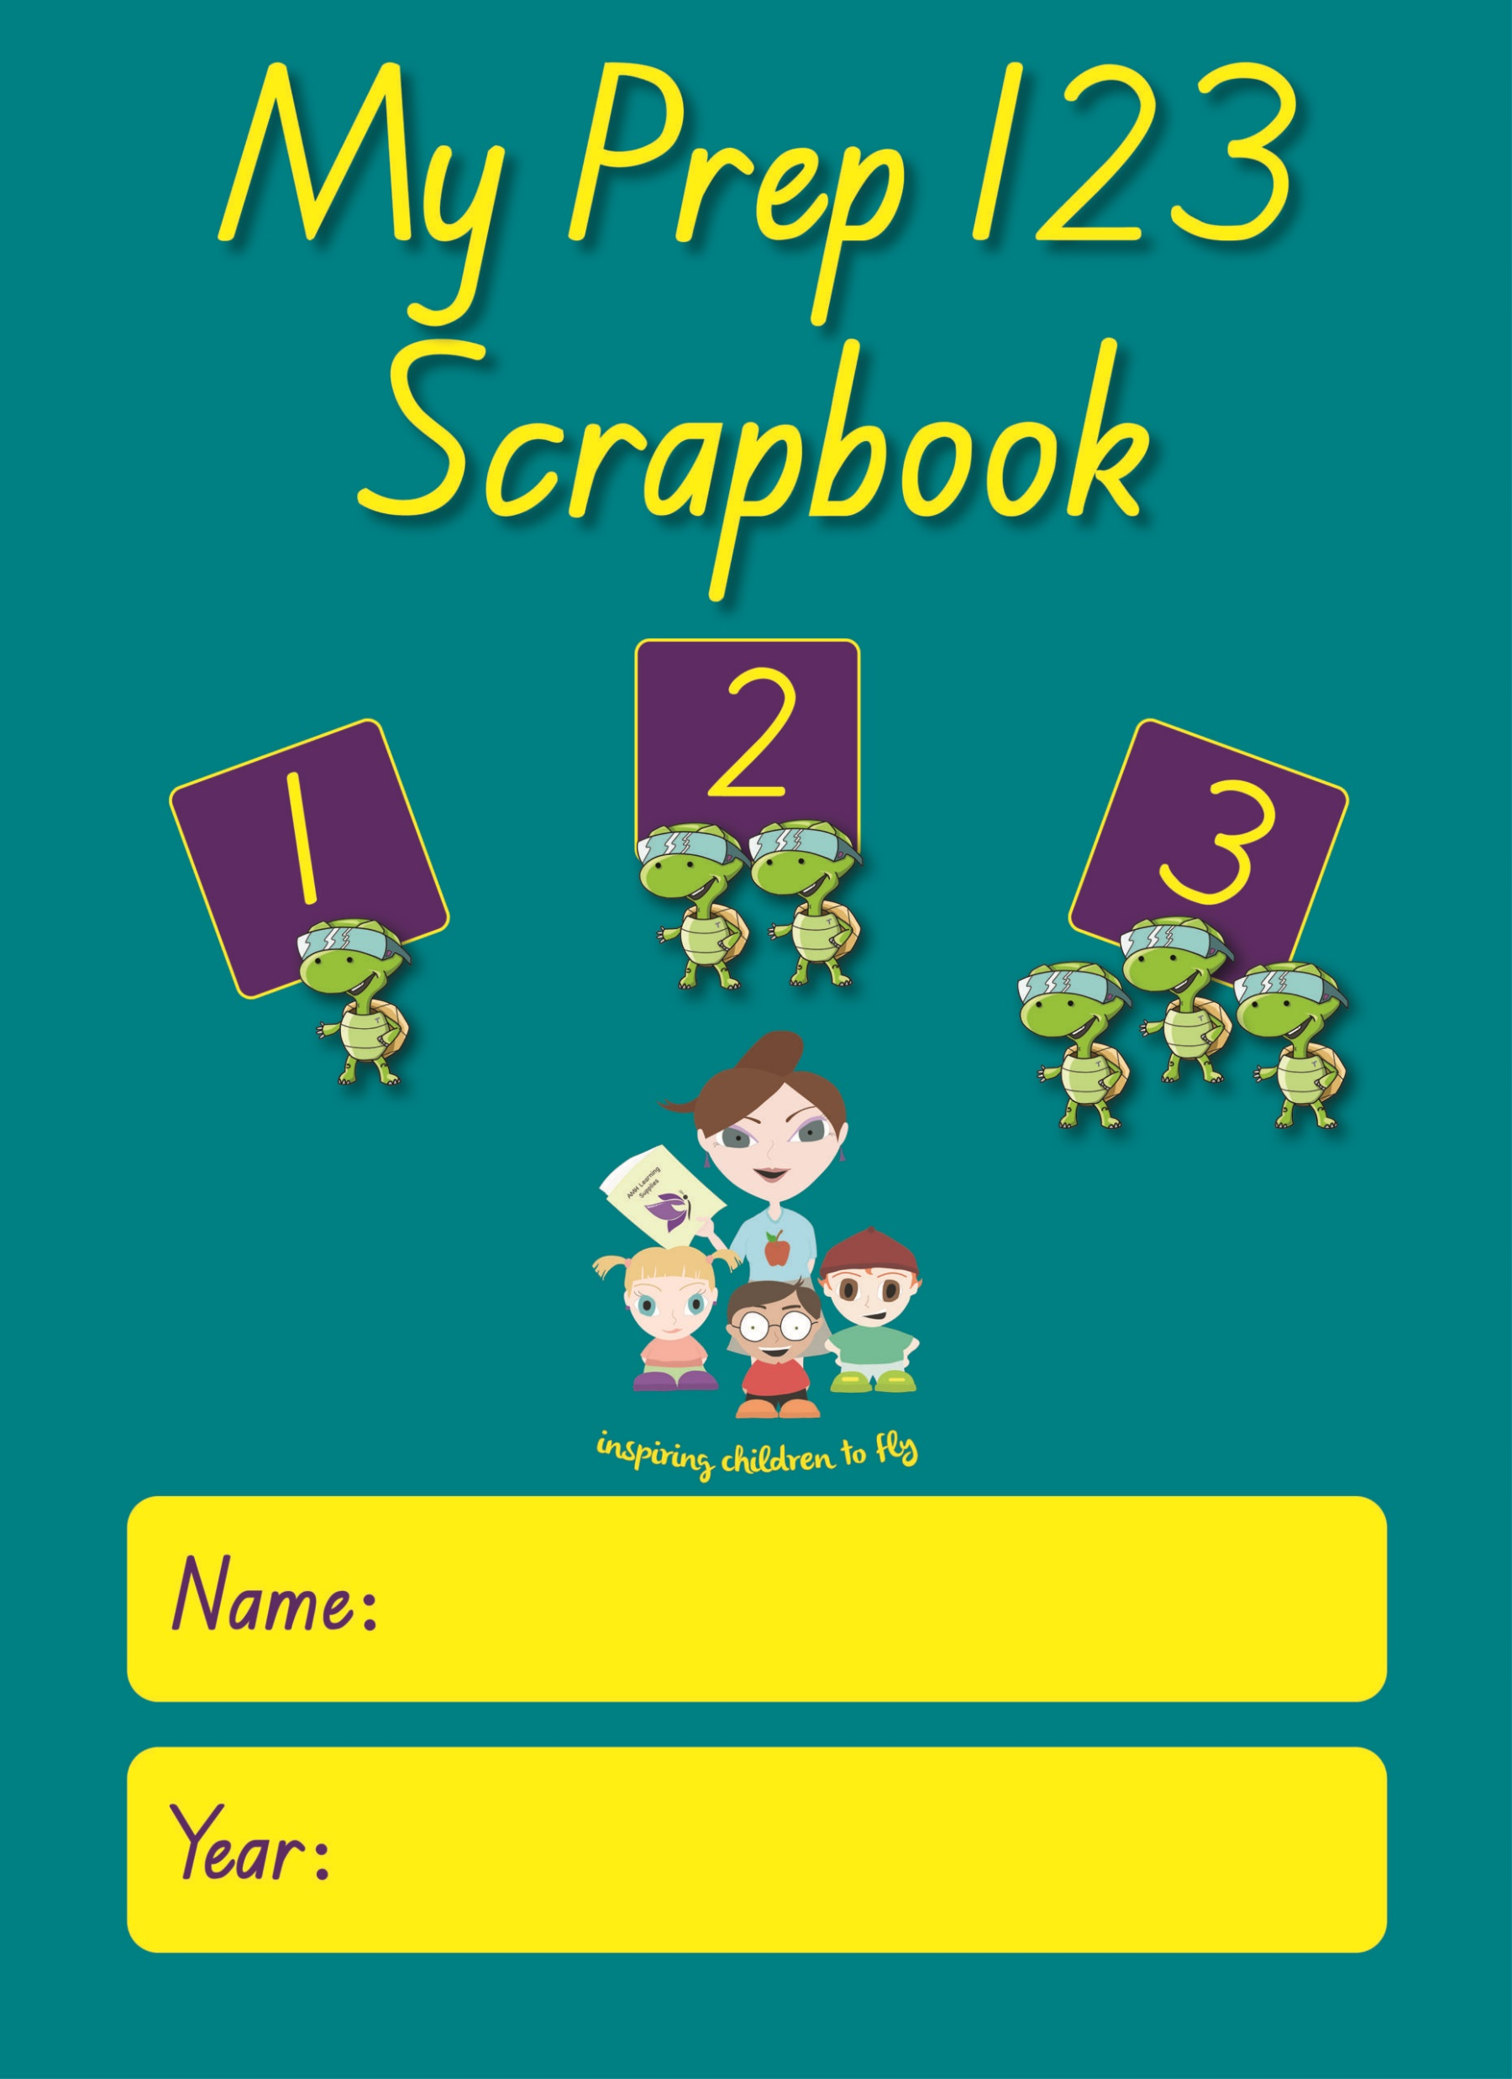
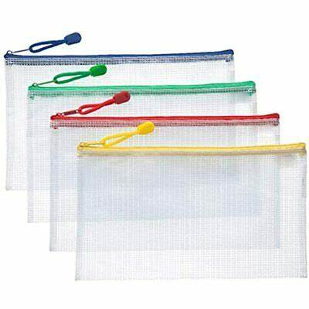
PREP BOOK LIST 2025
1 x Sharpener (2 hole, metal)
8 x Glue Sticks (UHU or Blustick)
3 x Boxes Tissues
3 x Boxes Lead pencils (HB)
6 Black Whiteboard Markers
1 x Ruler
4 x Eraser
1 x Pencil Case
1 x Scissors
4 x Boxes coloured Pencils (triangular)
1 x Display Folder
2 x A4 Plastic Wallets clear
2 x reams A4 paper
8 x Yr 1 Exercise Books (A4)
4 x Scrapbooks – No lines
4 x Scrapbooks – with Lines
1 x My School Scrapbook (Pink)
1 x My Prep 123 Scrapbook (Blue)
**Purchase through school in 2025**
School will invoice parents in term 1
Please check your child’s supplies regularly throughout the year for replenishment eg. Glue, pencils etc.

Slide 2
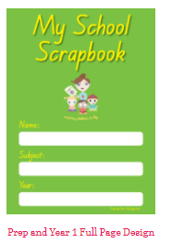
Yr 1 BOOK LIST 2025
8 x Glue sticks 35g
3 x Boxes Tissues
3 x Boxes Lead pencils (HB)
6 Black Whiteboard Markers
1 x Pencil Case
1 x Ruler
4 x Eraser
2 x Sharpener
1 x Pk Textas
1 x Scissors
4 x boxes of Coloured Pencils
1 x Display Folder
1 x box 80gsm laminating pouches
6 x Yr 1 Exercise Books (A4)
2 x Scrapbooks (No lines)
1 x A3 plastic zip wallet (Clear)
1 x My School Scrapbooks
*purchase through school*
Please check your child’s supplies regularly throughout the year for replenishment eg. Glue, pencils etc.

Slide 3
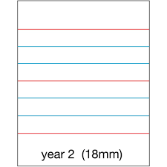
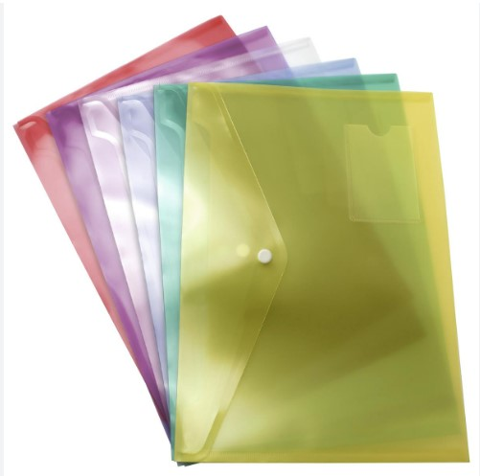
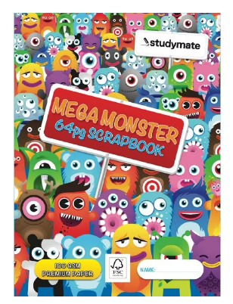
Can be used from previous year.
Yr 2 BOOK LIST 2025
1 x Earphones (USB style to plug into computer)
1 x 8gb USB with Lanyard
2 x Sharpeners
6 x Glue Sticks
3 x Boxes Tissues
3 x Boxes Lead pencils (HB)
6 Black Whiteboard Markers
2 x Wooden Rulers
4 x White Erasers
1 x Pencil Case
1 x Scissors
1 x pk Coloured Pencils
1 x pk Faber-Castell Textas
2 x Clear Plastic Folders (Button closure)
2 x Reams A4 Paper
10 x A4 Yr 2 Exercise Books
8x Scrapbooks (no lines)
2 x A4 10mm Quad Books
2 x Homework Folders (zip style)
1 x old shirt/smock for art
Please check your child’s supplies regularly throughout the year for replenishment eg. Glue, pencils etc.

Slide 4
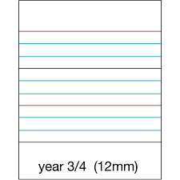
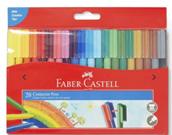
Can be used from previous year.
Yr 3 BOOK LIST 2025
1 x Earphones (USB style to plug into computer)
1 x 8gb USB with Lanyard
2 x Sharpeners
6 x Glue Sticks
3 x Boxes Tissues
1 x Pencil Case
3 x Boxes Lead pencils (HB)
6 Black Whiteboard Markers
1 x pack 5 Highlighters
2 x Wooden Rulers
4 x White Erasers
1 x Scissors
1 x pk Coloured Pencils
1 x pk Faber-Castell Textas
2 x Clear Plastic Folders (Button closure)
1 x 80 gsm Laminating pouches
8 x A4 Yr 3/4 Exercise Books
8 x Scrapbooks (no lines)
2 x A4 10mm Quad Books
2 x Homework Folders (zip style)
1 x smock or old shirt
Please check your child’s supplies regularly throughout the year for replenishment eg. Glue, pencils etc.

Slide 5
Can be used from previous year.
Yr 4 BOOK LIST 2025
1 x Earphones (USB style to plug into computer)
1 x 8gb USB with Lanyard
2 x Sharpeners
6 x Glue Sticks
3 x Boxes Tissues
1 x Pencil Case
2 x Boxes Lead pencils (HB)
6 BLACK Whiteboard Markers
2 x Wooden Rulers
4 x White Erasers
1 x 5 pkt Highlighters
1 x Scissors
1 x pk Coloured Pencils
1 x pk Faber-Castell Textas
4 x Clear Plastic Folders (Button closure)
2 x Reams paper
8 x A4 Yr 3/4 Exercise Books
8 x Scrapbooks (no lines)
2 x A4 10mm Quad Books
2 x Homework Folders (zip style)
1 x 24 pk Crayola Crayons
1 x smock or old shirt
Please check your child’s supplies regularly throughout the year for replenishment eg. Glue, pencils etc.

Slide 6
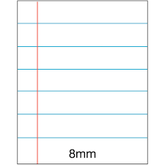
Can be used from previous year.
Yr 5 BOOK LIST 2025
1 x Earphones (USB style to plug into computer)
1 x 8gb USB with Lanyard
2 x Sharpeners
6 x Glue Sticks
3 x Boxes Tissues
1 x Pencil Case
3 x Boxes Lead pencils (HB)
3 x Blue Pen
3 x Red Pen
2 x Wooden Rulers
4 x Erasers
1 x Scissors
1 x pk Coloured Pencils
1 x 5 pkt x Highlighters
1 x pk Faber-Castell Textas
1 x pk Sticky Notes (7.5cm square)
2 x Reams A4 Paper
8 x A4 Exercise Books (feint lines)
2 x A4 7mm Quad Books
8 x Scrapbooks (no lines)
2 x Homework Folders
1 x box 80gsm laminating pouches
Please check your child’s supplies regularly throughout the year for replenishment eg. Glue, pencils etc.

Slide 7
Can be used from previous year.
Yr 6 BOOK LIST 2025
1 x Earphones (USB style to plug into computer)
1 x 8gb USB with Lanyard
2 x Sharpeners
6 x Glue Sticks
3 x Boxes Tissues
1 x Pencil Case
3 x Boxes Lead pencils (HB)
2 x Blue Pens
2 x Red Pens
2 x Wooden Rulers
4 x Erasers
1 x Scissors
1 x pk Coloured Pencils
1 x 5 pk highlighters
1 x pk Faber-Castell Textas
1 x pk Sticky Notes (7.5cm square)
2 x Reams A4 Paper
8 x A4 Exercise Books (feint lines)
2 x A4 7mm Quad Books
8 x Scrapbooks (no lines)
2 x Home work Folders (zip style)
1 x box 100 A4 plastic sleeves.
Please check your child’s supplies regularly throughout the year for replenishment eg. Glue, pencils etc.

